Slide 1
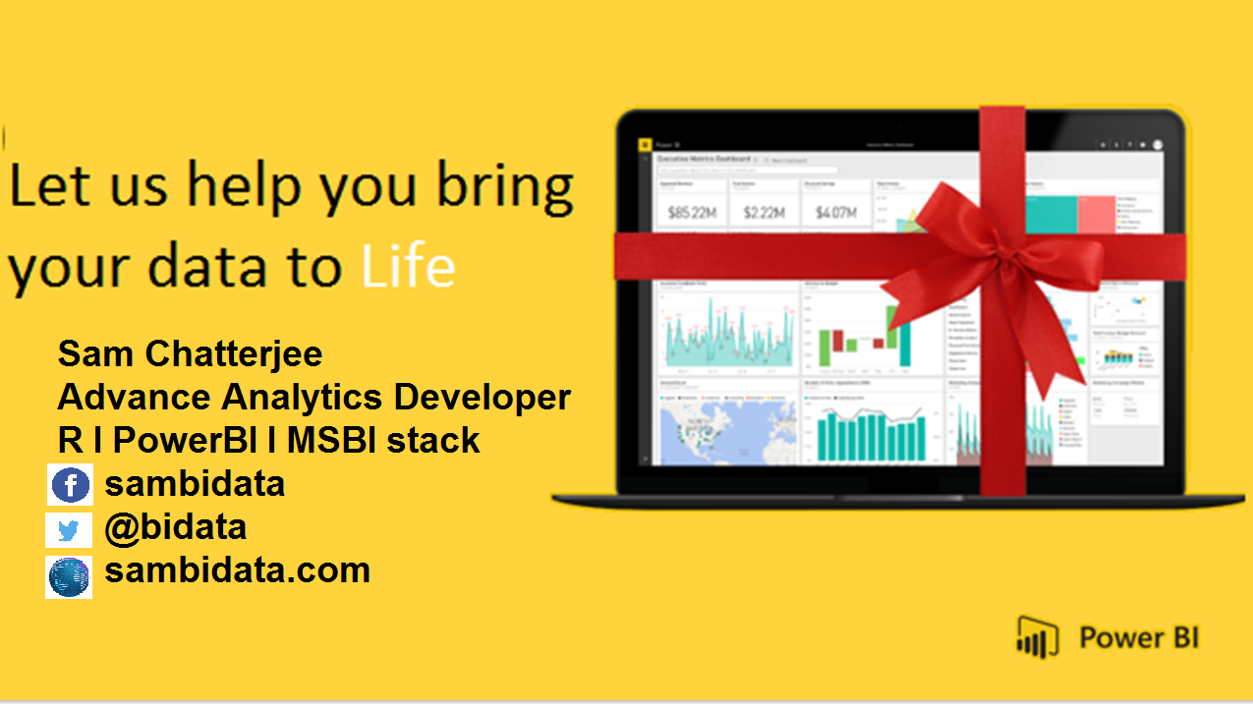

Slide 2
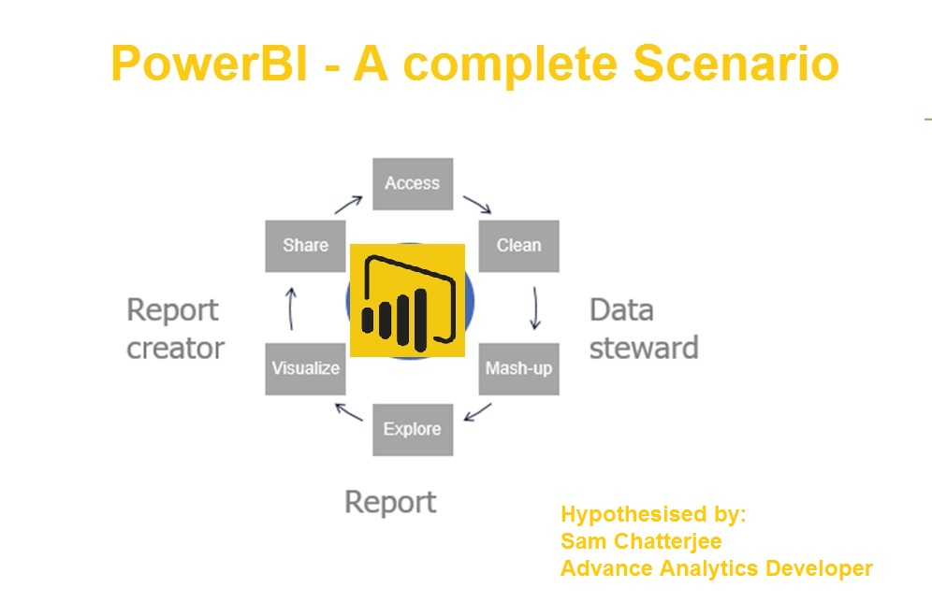


Slide 3
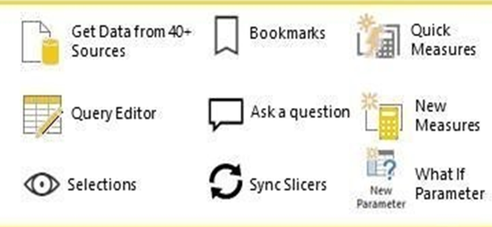
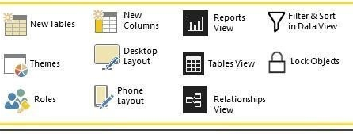
POWERBI
DESKTOP

Slide 4
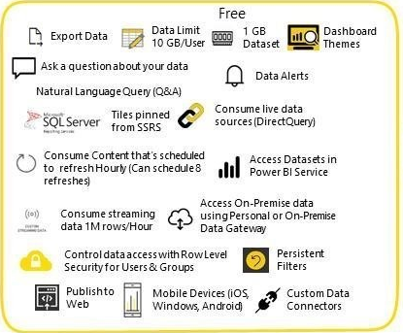
POWERBI SERVICE

Slide 5
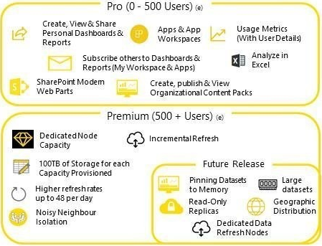

Slide 6
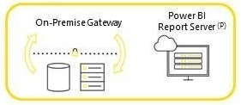
ON POWERBI SERVICE

Slide 8
LAST THINGS FIRST
PowerBI PRO has to be installed first.
Author and Reciepnt must both be powerbi pro users.
Your Office 365 admin assigns Power BI Pro Licences, and you pay per user per Month.
There is an alternative to shared capacity where you purchase dedicated capacity via Power BI Premium.
As a Power BI Pro User, you share content to Premium capacity that any number of free users can consume.
There are also free options to share data as listed below.

Slide 9









P O W E R B I S H A R I N G
Share Dashboard
Share Template
Apps
- Publish reports from desktop to dashboard.
- Share your report inside of your organization
- Save PowerBI template file with pbit
- Distribute content to self-service.
Content deployed to an App.
Users will be able to visualize app.
PowerBI Premium
Embed within Microsoft Teams
Content Packs
-Shared capacity limits of 1GB per dataset.
-Shared infrastructure with other PowerBI
- Office 365 groups that governs the security.
- EM SKU’s are significantly work more.
-Your package for content packs.
- Consume by other users
Share PBIX
B2B for Guest users
Export to Excel
- On Premises without PowerBI-pro license
- Encapsulate file with a PBIX extension.
Azure AD business-to-business collaboration.
Deploy content to premium capactity.
Export the data to csv or excel.
Build visualization with the method.

Slide 10
SHARE DASHBOARDS
There Is An Important Distinction Between Reports And Dashboards.
Explanation Blocks
75%
Create Reports By Visualisations
Maximum extent of visualisations
You can create reports within PowerBI desktop.
Adding visualisations to the report page.
87%
Reports can have many pages
Number of pages help
Option to drill-down from high-level page.
Transfer the report to some lowlevel page.
52%
Publish the content to powerbi.com
Fullest extent of publishing
Publish the content to the cloud service subsequently.
Overarching visualisations through pinning
78%
Create Dashboards.
Create dashboards
Publish dashboards inside or outside your organization
Recipients of the share requires a PRO-LICENSE

Slide 11
POWER BI PREMIUM
Default mode is for to deploy content to shared capacity in PowerBI Service.
Explanation Blocks
75%
Distributing content
Extent of distribution
Distributing content from shared capacity
Author and consumer require a PRO License.
87%
As Alternative, Deploy Content
Deployable
Deploy content to dedicated capacity via premium.
More security of features interms of deployability.
52%
3 Distinct Benefits
Distince benefits with user
User consuming content can be a free user.
Shared capacity is far more leninent with premium.
Purchasing required dedicated resources
78%
Availability
Availability
PowerBI premium available in 3 differnet formats.
“A”, “EM” and “P”

Slide 12
SHARED CAPACITY LIMITS
DATASET LIMITS FOR SHARED CAPACITY.
Explanation Blocks
75%
1 GB per dataset- FREE
Speed with 1GB
Shared capacity limits of 1GB per dataset.
10GB per user and 8 refreshes per day.
87%
10GB of dataset is available - premium
Speed with 10GB
100TB of storage is available
Refresh is 48times per day.
52%
Purchasing PowerBI provides
Purchasing powerbi
Dedicated resources.
Data visualisations are amazing.
78%
Sharing helps
Sharing helps
Here you can add something in brief as the explanation of these percentage infographics

Slide 13

POWERBI CONTENT THROUGH
.PBIX SHARING s
02
01
Development environment for creating content is powerbi desktop
Encaosulate content as a file with pbix extension. File is ready to be shared
All users can collaborate on-premises using this method for free with colleagues
This sharing must be avoided to distribute content to self-service end-users
03
04

Slide 14
POWERBI TEMPLATE THROUGH
.PBT SHARING s
02
01
Template allow you to save the development content of your work.
Difference being the template file contain an empty dataset-not imported data.
Share free with colleagues
Again, this sharing must be avoided to distribute content to self-service end-users
03
04

Slide 15


Embed with Microsoft Teams
Embed PowerbI content within Microsoft Teams, using “users own data” We can achieve this through these steps
01
Office 365 groups
Govern the security of PowerBI workspace and Teams
Can be used to provide a consistent authentication mechanism both products.
02
Deploy Office 365 groups
Premium capacity on P.
EM capacity is much cheaper than P

Slide 16



03
Embed with Sharepoint online
Embed with the reports on online basis with the SharePoint
04
Content Packs
This a sample text and here you need to put your own text and ideas that fit
05
Embed within Teams
To distribute powerbi pro users using shared capacity without requiring premium capacity

Slide 17






APPS WORKSPACE
PERMISSION TO USERS
PERMISSIONS WORKSPACE
Users can then be assigned permission to view the content within that workspace.
App development
DEPLOY CONTENT
Edit permission on a workspace.
Edit content within PowerBI service.
Powerbi pro user can deploy content to an app workspace within the powerbi service.
-Users are assigned to consume the app from menu item.
PRIVILEGE LEVELS
DEPLOY CONTENT
Two priviliege levels when assigning workspace permission.
View-only is still a fully interactive experience where user can apply FILTERS / SLICERS.
To deploy content to the cheapest SKUs in addition
PowerBI embedded to the deploy content

Slide 18
CONTENT PACKS & PUBLISH TO WEB
Package items within a content pack.
Assign permissions to that single entry for consumption by other users.
For free users share report via powerbi service.
PowerBI admin has the right to turn off the images
Content packs
Data Link
Audience
Package items
Publish to web
- Superseded by PowerBI apps
- Such users can click the get data link in the powerbi service
Import a content pack into current workspace.
- No such authentical req.

Slide 19
Export to PowerPoint or Excel
Negligible interactive
Reports can be shared with 3rd party
Features can be turn off my admin
Click on the export file to get the view.
Create dashboarding on each of the file particularly.
Powepoint
Excel
Share
Interactive
CSV
Export reports to PowerPoint via powerbi service.
It requires a non-interactive static version without drill down, slice or filter data.
Reports can be export to csv / excel.
Get report

Slide 20
B2B for Guest Users
Azure AD business-to-business(B2B) collaboration gives you the ability to add users from another tenant as a guest.
6. Not any other tenant including own.
2. Deploy content to premium capacity.
4. User brings their own PRO License
6
1.External User can see the powerbi content with a single sign-on.
4
5. Assigned license provide the ability to view pro content
2
3. Deploy content to shared capacity
5
1
3

Slide 21
ON PREMISES REPORT SERVER
For customers concerning over data sovereginty and deploying data to the cloud,there is an option of the on-premises PowerBI server.
3 Cloud services
4 SQL server EE
1 Report server
- Available for SQL server EE those who want to be with assurance
2 Purchase PBI server
3
1
- Purchase it via PowerBI Premium
4
It is a superset of traditional SQL server reporting services(SSRS) installation
- it allows you to deploy powerbi reports in addition to paginated SSRS reports
2
- Using report server and premium allows you to migrate the on-premises installation to cloud-based premium capacity in the future

Slide 22


DIFFERENT SHARING CONCEPTS
CONTENT PACKS
POWERBI DESKTOP
POWERBI REPORT SERVER
POWERBI APPS
POWERBI PRO
POWERBI SERVICE
PUBLISH TO WEB

Slide 23
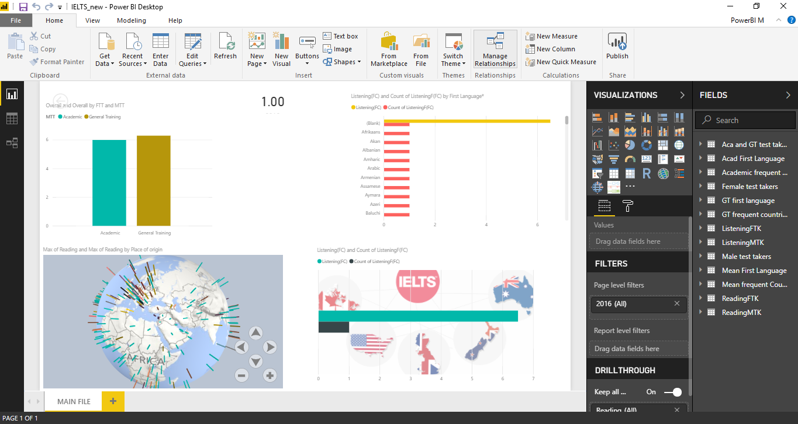
POWERBI DESKTOP

Slide 24
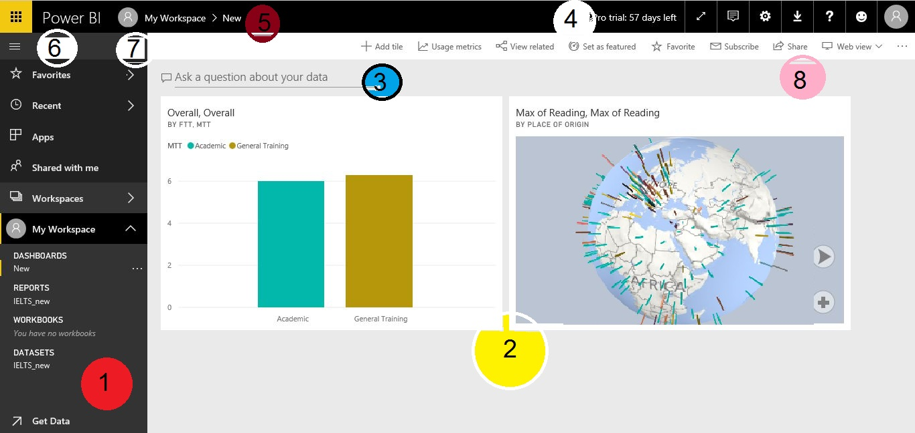
POWERBI SERVICE

Slide 25
POWERBI SERVICE
The main features of your Power BI service UI are the following:
navigation pane (left nav)
canvas (in this case, dashboard with tiles)
Q&A question box
icon buttons, including help and feedback
dashboard title (navigation path, aka breadcrumbs)
Office 365 app launcher
Power BI home button
Labeled icon buttons

Slide 26
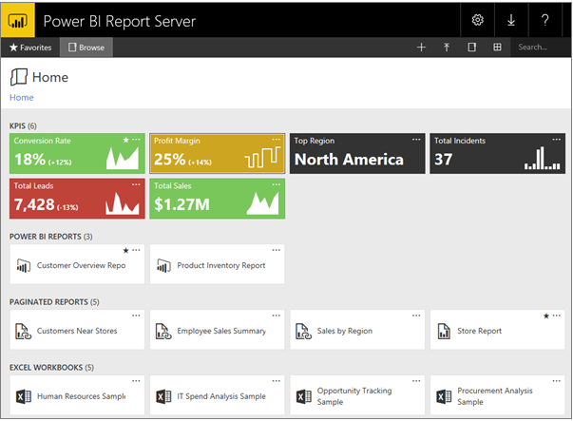
POWERBI REPORT SERVER
Power BI reports created with Power BI Desktop in the web portal and the Power BI mobile apps.
Paginated reports created in Report Builder: Modern-looking, fixed-layout documents optimized for printing.
KPIs created right in the web portal.

Slide 27
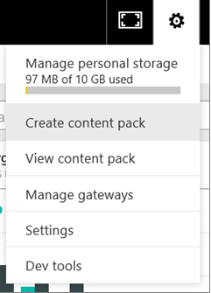
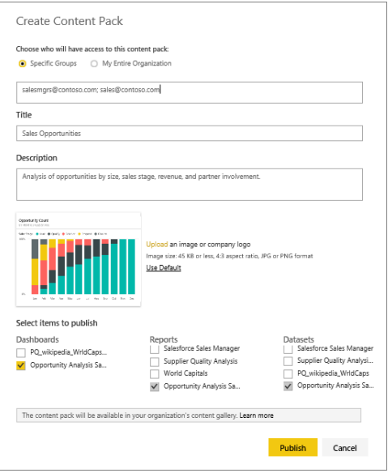
CREATE CONTENT PACK

Slide 28
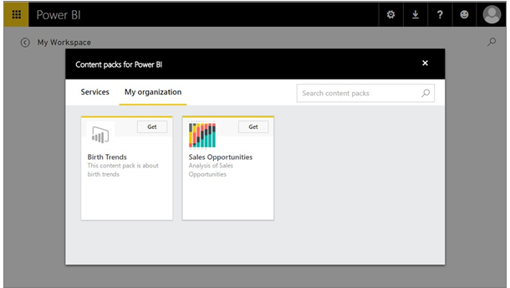

Slide 29
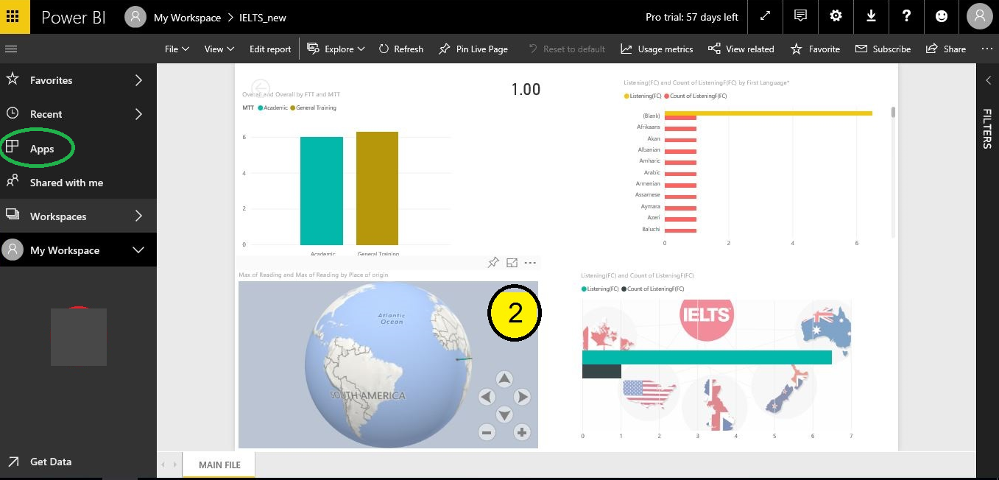
POWERBI APPS

Slide 30
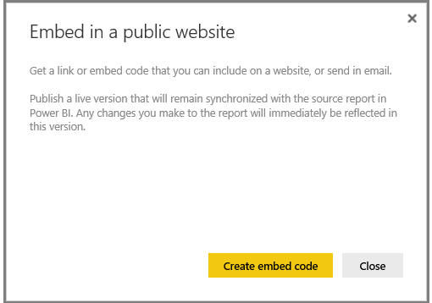
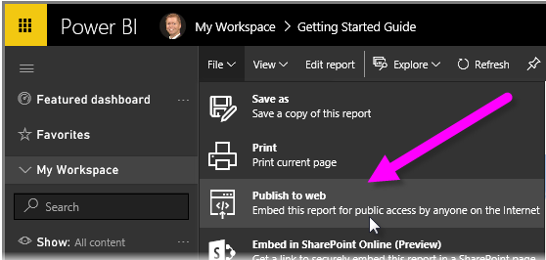
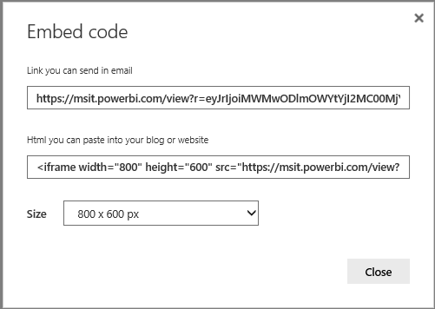
PUBLISH TO WEB

Slide 31


Slide 32

POWERBI VERSIONS DIFFERENCES
POWERBI FREE
3
Available but without collaborative elements.
Nice to use for 1 users to explore.
Limited value to integrate data sources
Required 12 month commitment
Comes in 3 tastes small(p1), medium(p2) and large(p3).
For p1 650 USD as a start per month
Dedicated cloud service for powerbi.
-Allow people to access PowerBI reports without a pro license or server as a cloud service.
-For example SAAS.
-
POWER BI PREMIUM
1
POWERBI PRO
Perform a free 60-days evaluation.
Remains the fully functional tool.
Use for reporting or create dashboarding.
Integrate data and build data models.
2
The Power BI Premium is a replacement of the Power BI Embedded version

Slide 33
POWERBI PROJECT-VARIABLES
DATASOURCE
LOCATION
DATASET
SECURITY
COMPATIBILITY
INQUIRY
DATAMIGRATION
- Analysis Services.
Database.
Flatfile
Cloud
On-premises
-Import
-Direct Query.
-Live connection
- Streaming
-Row level
-Column Level
Connectors.
SAP HANA
- Q&A
- Data visualization
Powerbi project variables on working with powerbi data sources on datasets to publish it in the first place.

Slide 34




Resources
Get Power BI (Free) http://tinyurl.com/hj5hdg6
Power BI Jump Start http://bit.ly/1ktON16
Power BI Getting Started http://bit.ly/1FF88KA
Power BI Team Blog http://bit.ly/1vwbTLG
Power BI Channel 9 http://bit.ly/1a9Q0gv
Power BI https://powerbi.microsoft.com

Slide 35
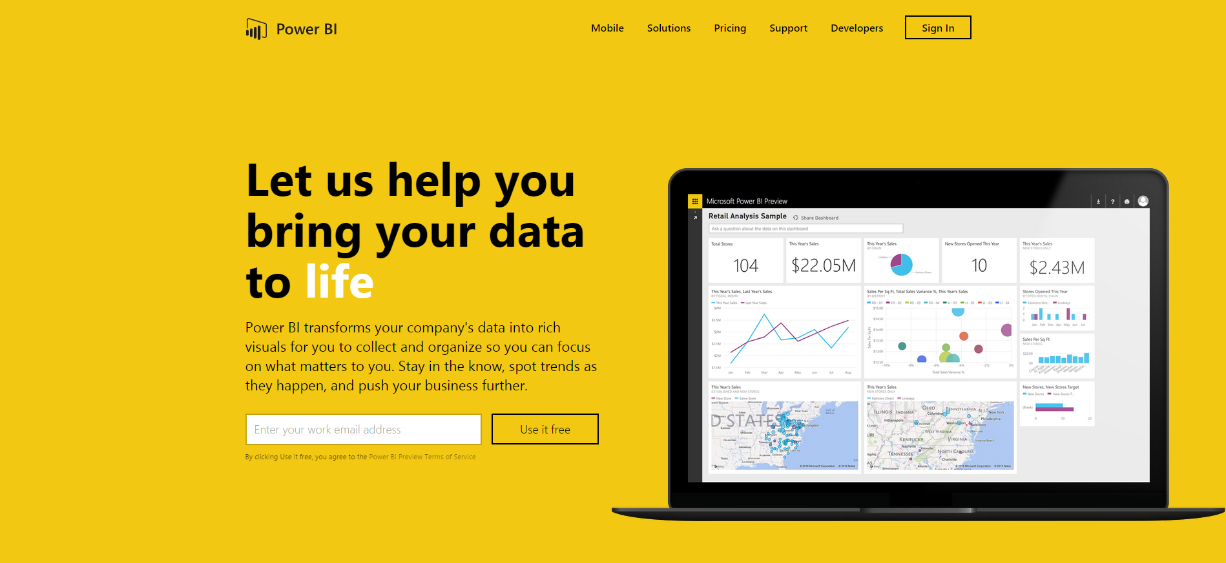
Thankyou for Coming to PowerBI
Sign up for a free Preview account
Take the Power BI Tour
Notes:
Thanks for taking the time to walk through the main capabilities of Power BI.
If you’re ready to start exploring what Power BI can do for you and your organization, please visit powerbi.com.

